Slide 1
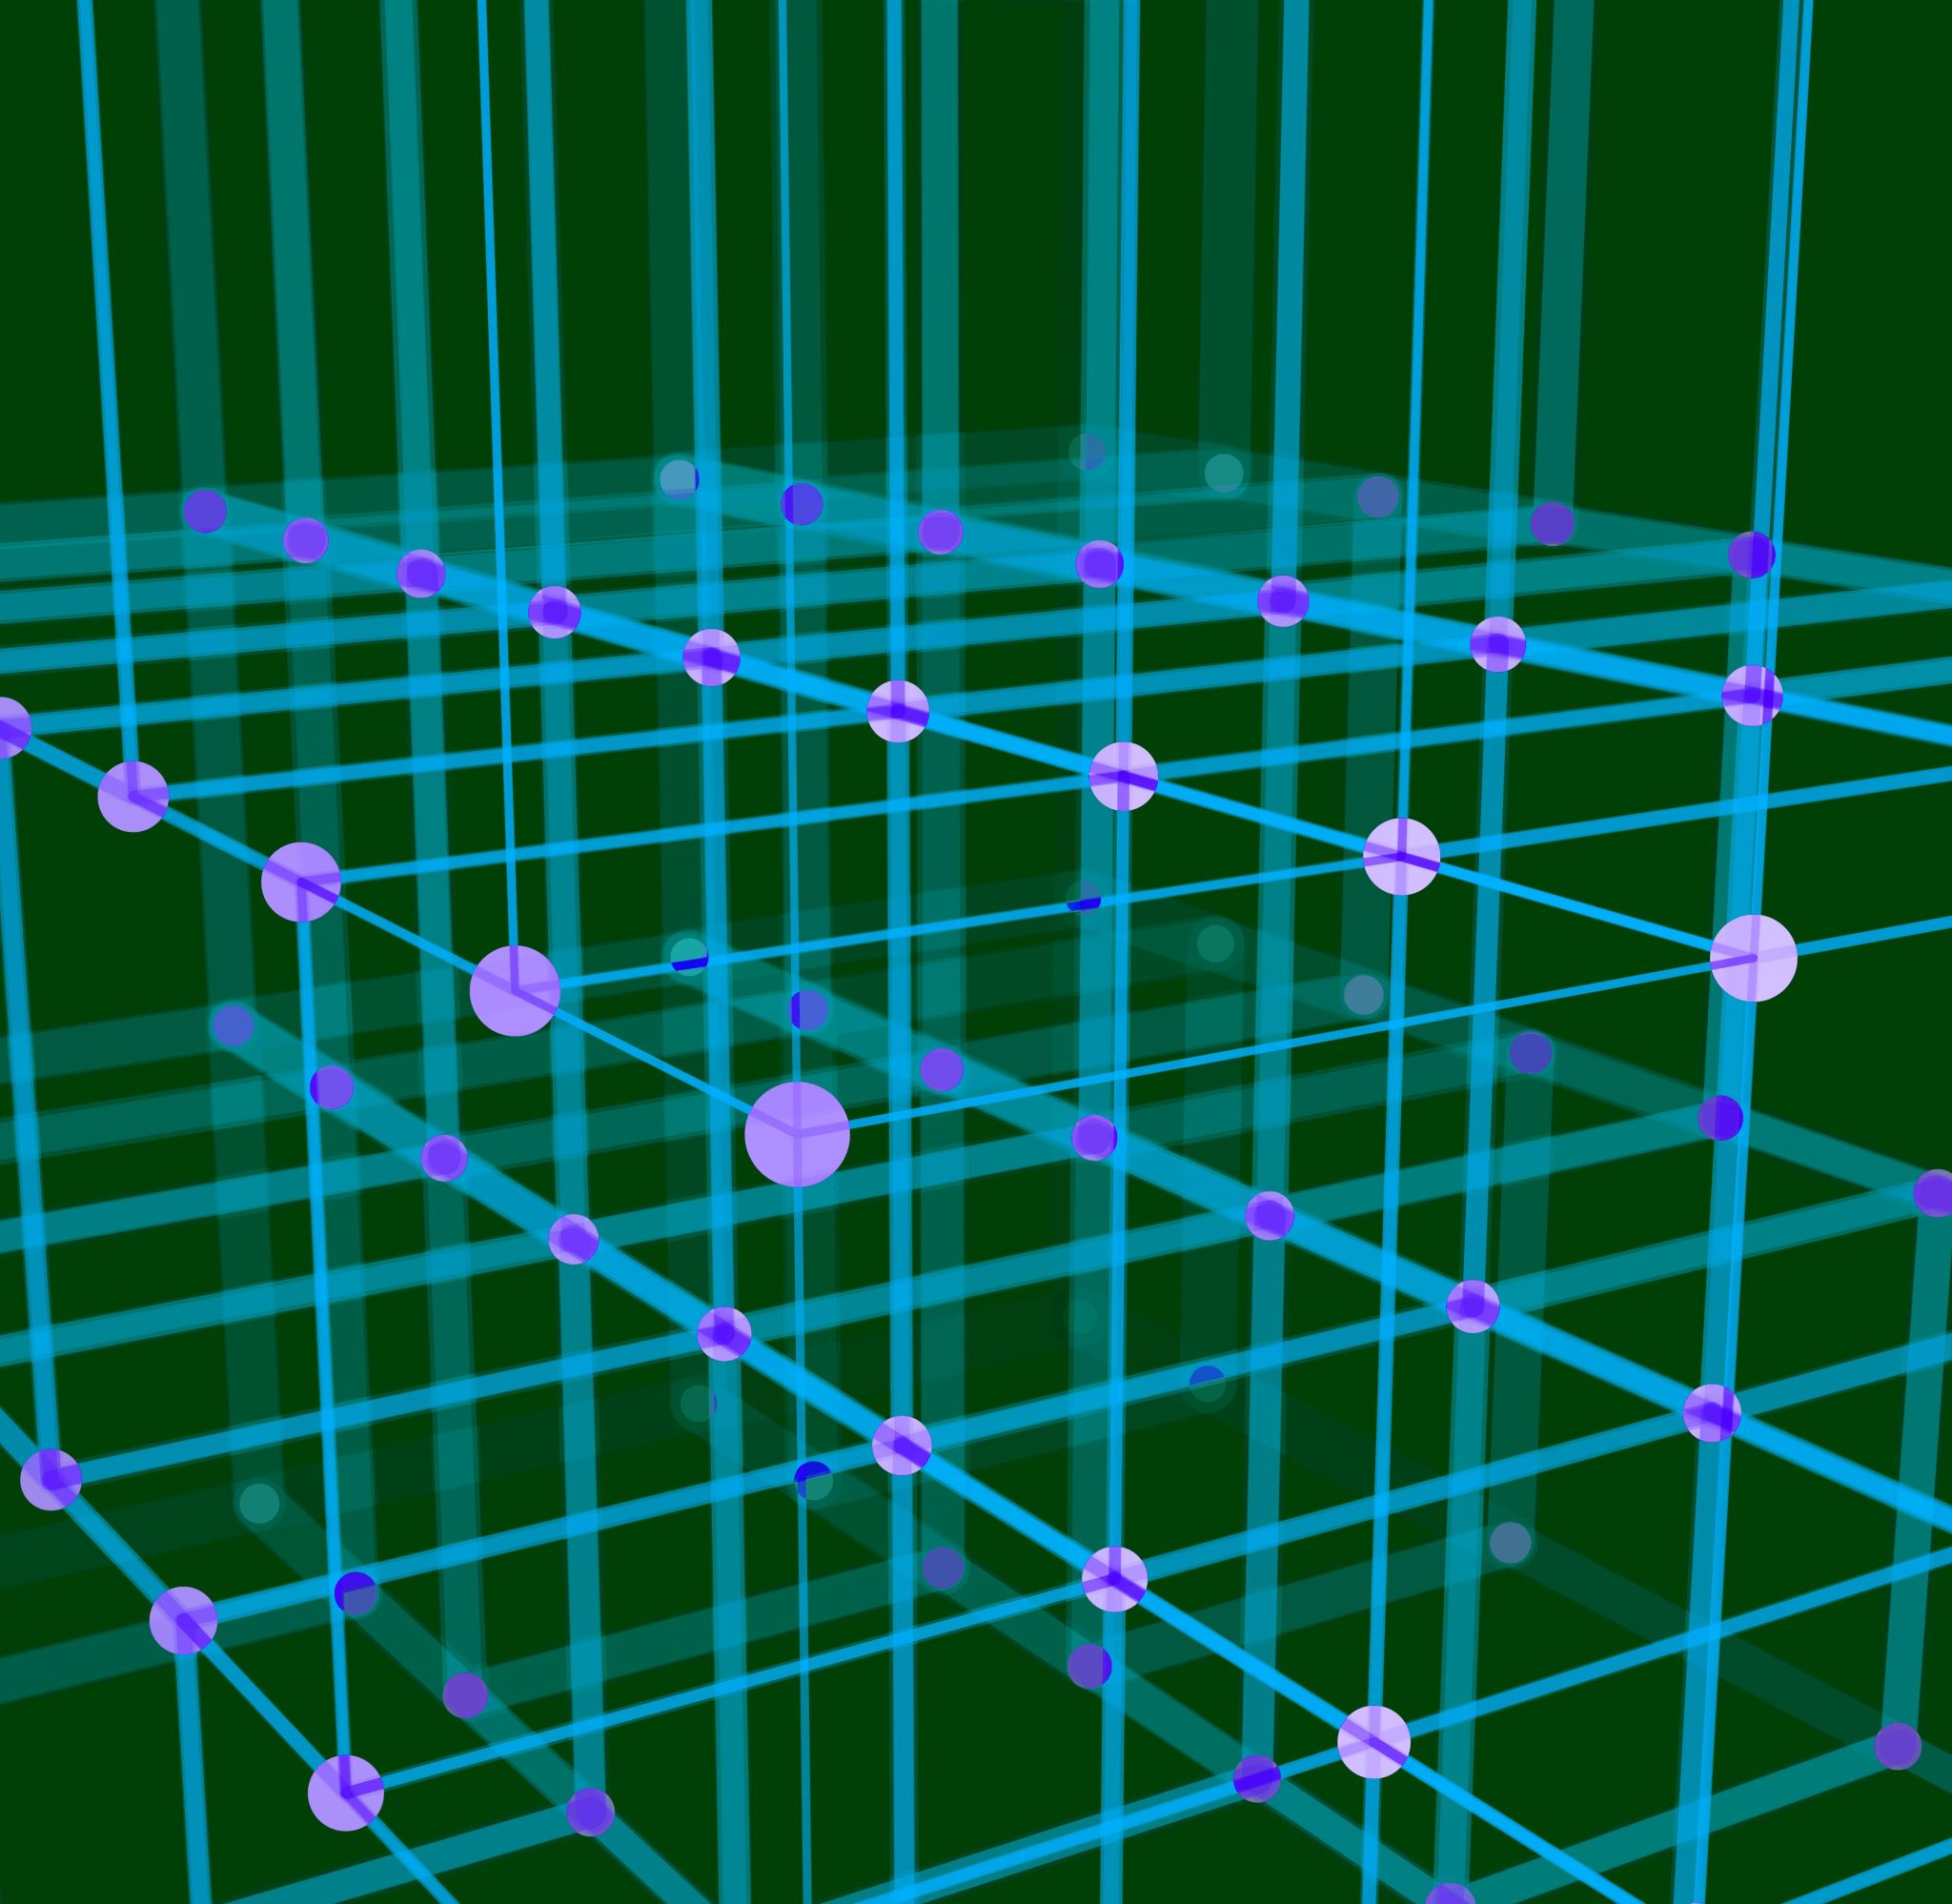
Generative AI
Nick en Pepijn

Slide 2
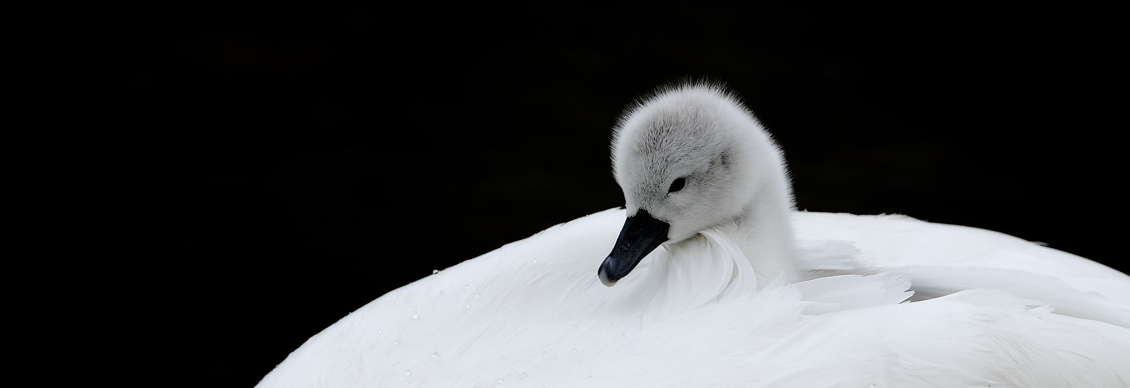
Inleiding
Generative AI
GANs
RNN

Slide 3
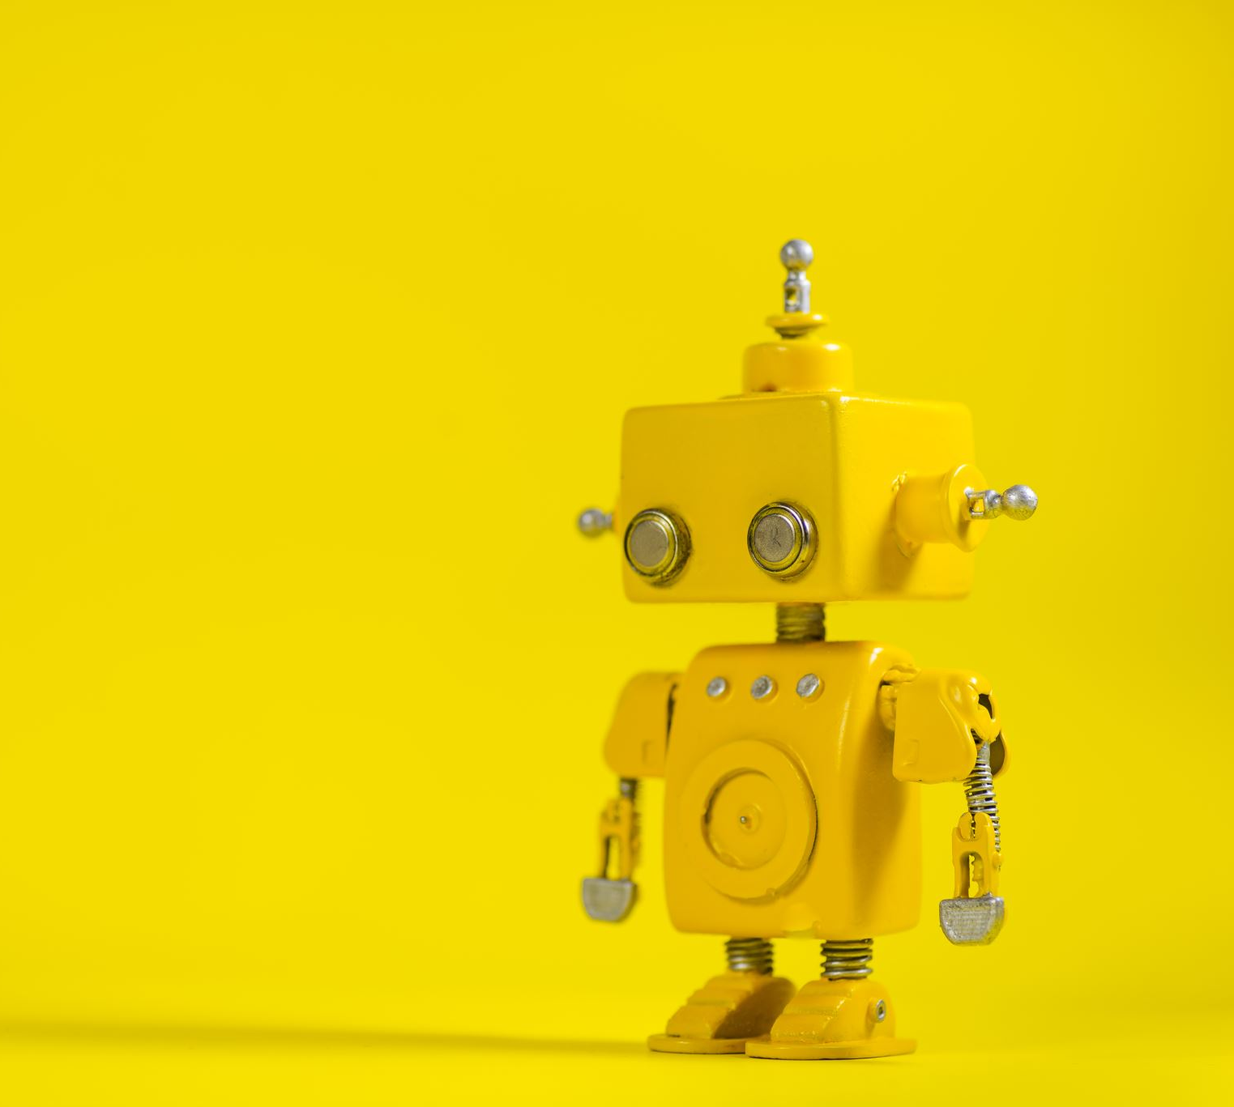
Generative AI
AI
Neural Network
AGI

Slide 4
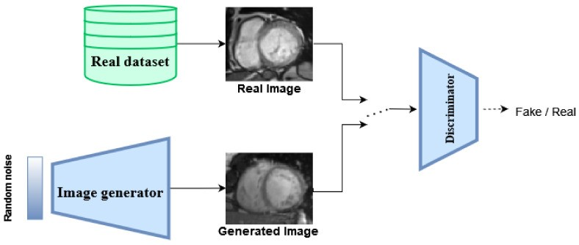
GANs
General Adversarial Networks
Ian Goodfellow
Generator
Discriminator
Midjourney
Deepfakes

Slide 5
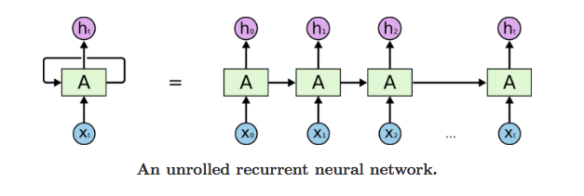
RNN
Recurrent Neural Network
Tekst
Onderdelen
Transformer

Slide 6
Conclusie
Onze mening
AI in de toekomst

Slide 7
Bronnen
[1] https://www.cloudflare.com/learning/ai/what-is-large-language-model/
[2] https://aws.amazon.com/what-is/artificial-general-intelligence/
[3] https://www.makeuseof.com/what-is-artificial-general-intelligence-how-it-differs-generative-ai/
[4] https://machinelearningmastery.com/what-are-generative-adversarial-networks-gans/
[5] https://www.youtube.com/watch?v=TpMIssRdhco
[6] https://www.ncbi.nlm.nih.gov/pmc/articles/PMC10055771/
[7] https://www.mediawijs.be/nl/artikels/wat-een-deepfake
[8] https://www.scribbr.nl/ai-tools-gebruiken/generative-ai-uitgelegd/
[9] https://www.youtube.com/watch?v=LHXXI4-IEns
[10] https://www.ncbi.nlm.nih.gov/pmc/articles/PMC5391725/
[11] https://aditi-mittal.medium.com/understanding-rnn-and-lstm-f7cdf6dfc14e
[12] https://www.baeldung.com/cs/hidden-layers-neural-network

